Slide 1
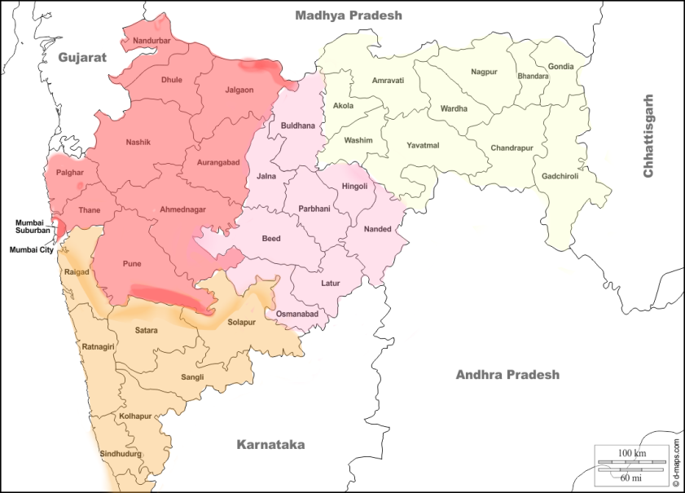
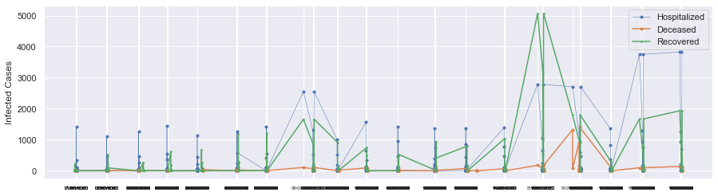
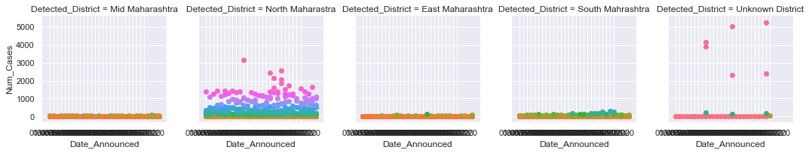
Analysis of Covid-19 in June through the Districts and State of Maharashtra
Red– North Maharashtra Pink – Mid Maharashtra Orange – South Maharashtra Yellow – West Maharashtra

